Slide 1
N on
Maximum
Suppression
Seth Park Vy-An Phan Tushar Singal Lichang Xu Jerry Zhao Simon Zimmerman Advisor: Bichen Wu

Slide 2
Overview
Project Description
Algorithm
Serial Code
Parallelization
Results

Slide 3
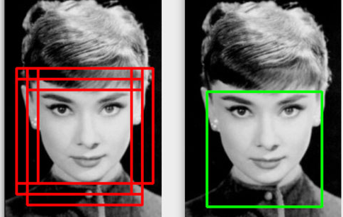
Project Description: What is NMS?
Non-Maximum Suppression - an intermediate step in many edge detection algorithms
Object detection may result in multiple results (shown by red bounding boxes)
NMS reduces them down to one box
Notes:
NMS is an intermediate step in the object detection pipeline.
Often, in this pipeline, we'll have many duplicate bounding boxes around the same object.
NMS is used to reduce this to a single bounding box per object.
To give an idea, we’re working with about 15000 bounding boxes per image. We’d like to reduce that to a handful.

Slide 4
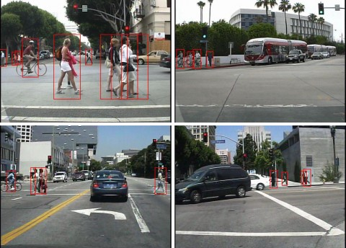
Project Description: Applications
NMS can get computation heavy!
Our application: detection of obstacles from a self-driving car’s camera
Requires speed for real-time data analysis and quick reactions
Notes:
NMS can get quite computation-heavy.
In fact, it is currently the bottleneck in the image processing pipeline.
Our motivation: By removing this bottleneck, we can process more features with more images at once.
This is critical for our application - self-driving cars - which require high accuracy and reaction times.

Slide 5
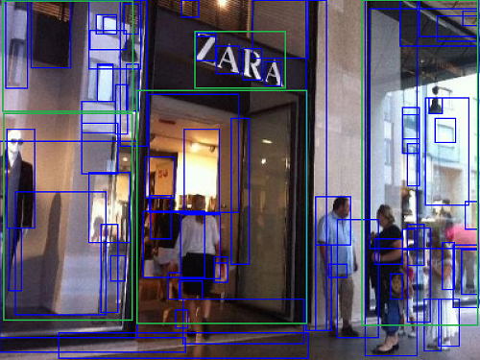
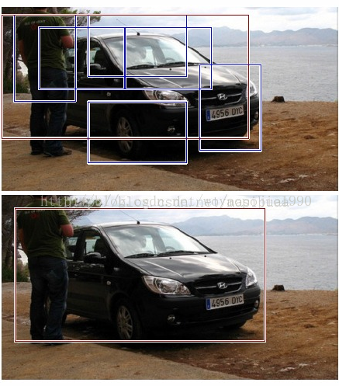
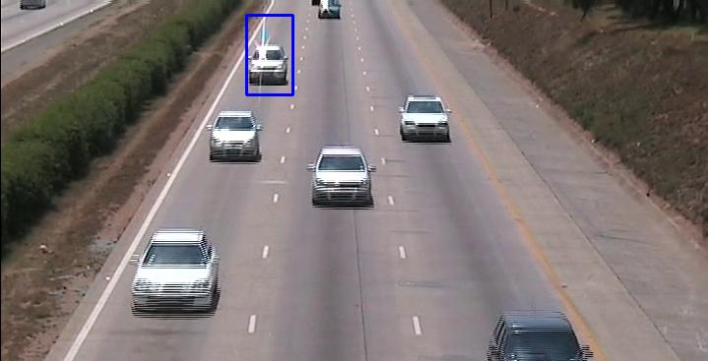
Project Description: Other applications
Facial recognition
Feature extraction
Satellite data analysis
Depth analysis
Medical scans
Notes:
There are various other applications to NMS - from facial recognition to medical scans.

Slide 6
Overview
Project Description
Algorithm
Serial Code
Parallelization
Results

Slide 7
Algorithm: NMS
Takes a list of bounding boxes (detected elsewhere)
Loop over bounding boxes and compute overlap ratios
Overlap ratio threshold is determined by the user
Boxes that overlap too much (overlap > threshold) are suppressed
Boxes detected with a higher probability are favored
Return a new list ignoring the redundant bounding boxes

Slide 8
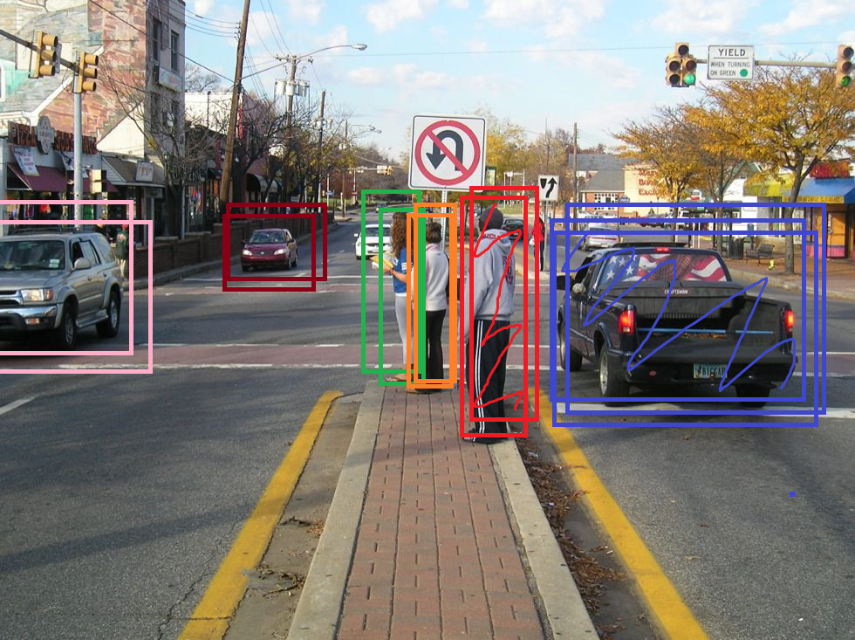
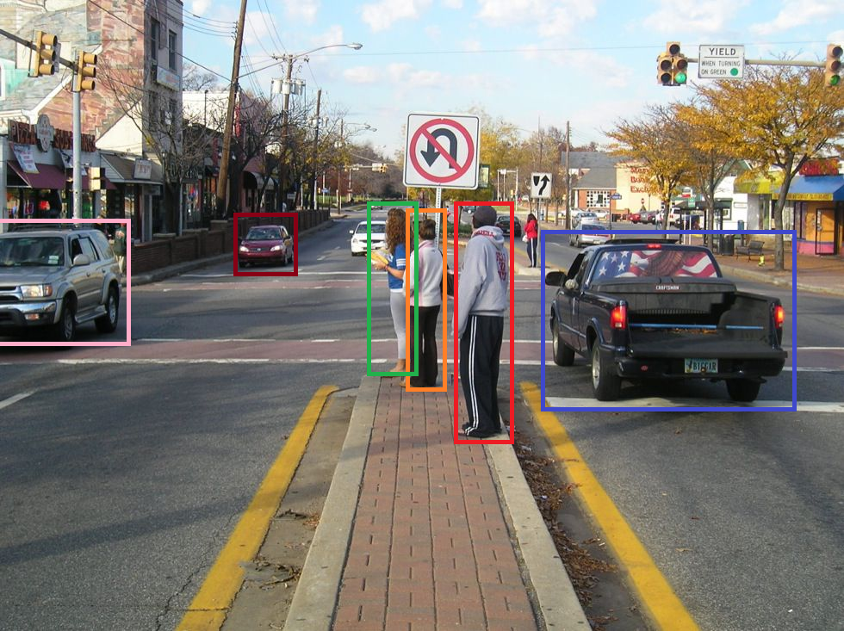
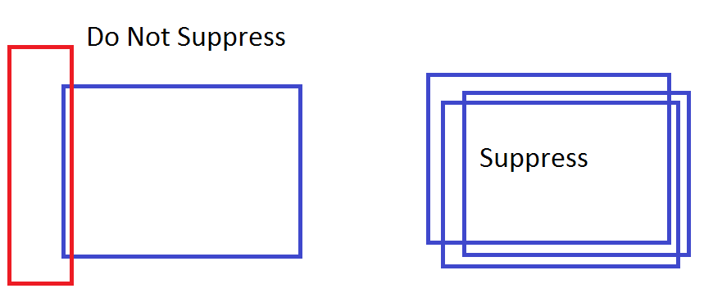
Algorithm: NMS

Slide 9
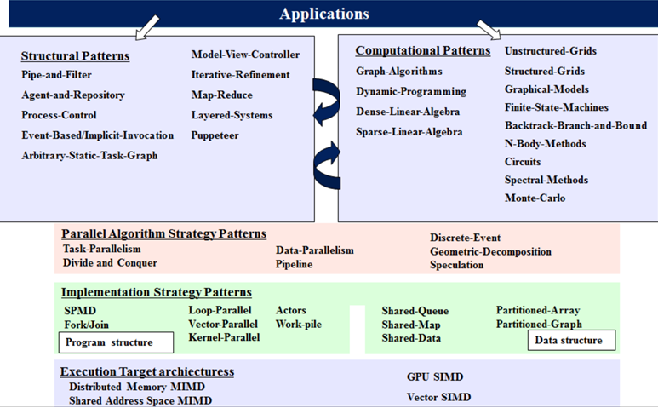
Algorithm: Patterns

Slide 10
Algorithm: Patterns

Slide 11
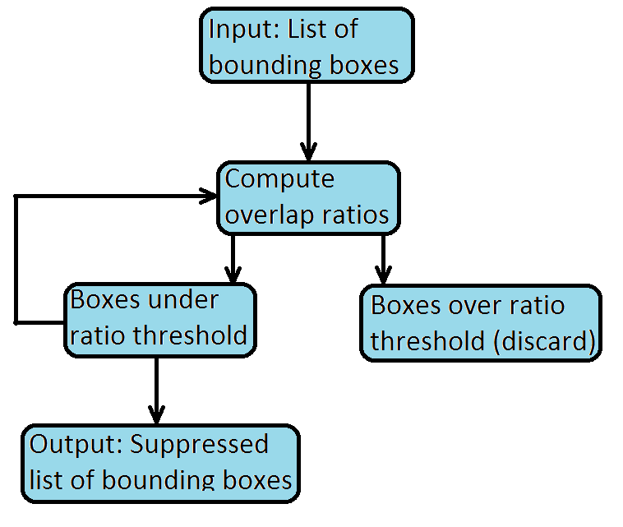
Algorithm: Patterns and Strategy
Despite the iterative step of this algorithm, it cannot be classified as iterative refinement because all comparisons must be performed.
There is no “refinement level” to reach

Slide 12
Algorithm: Patterns

Slide 13
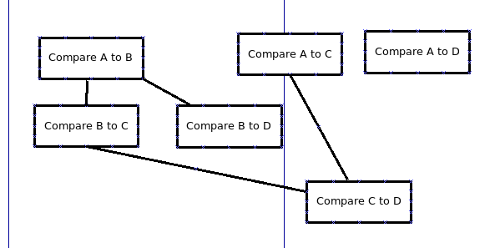
Algorithm: Patterns
Each comparison is its own task
Future comparisons dependent on results of previous comparisons
Cut away tasks/comparisons as you realize they are unnecessary

Slide 14
Algorithm: Patterns

Slide 15
Algorithm: Patterns
Task parallel - two possibilities
Assign tasks to comparisons; each comparison is a task
Assign tasks to boxes; determining if we want to keep box X is a task
Data parallel
We compare box i to all other boxes
Box i is represented by 4 arrays, xmins[i], ymins[i], widths[i], heights[i]
Each comparison is data parallel over the dimensions of the other boxes

Slide 16
Overview
Project Description
Algorithm
Serial Code
Parallelization
Results

Slide 17
Serial Code: Initial Layout
We started with python serial code
Double-nested for loop and lots of memory accesses
Took about 5min to run for 100 images, each with ~15000 boxes
~3s per image
This method cannot react in real-time for a car camera going at 60 fps
Translate to C
Simple translation, same logic
No parallelism, but got ~100x speedup anyway simply by language choice
Compiled with -O2 -funroll-loops

Slide 18
Serial Code: Diagram
In first pass of outer for loop, we note these boxes are the same, and discard many future comparisons. This is efficient! But done in serial.
Probability
Initially, we believe we should keep every box. The boxes are ordered by their detection probabilities. (Boxes[0] has highest probability)
For i if keep[i] == True:
For j > i if keep[j] == True:
If R > iou_compare(j, i):
Keep[j] = False
Note:
Rows in diagram correspond to i, columns correspond to j
Each box represents a comparison between box i and box j
 |  | X |  |  | X | X | X
Probability

Slide 19
Serial Code: Unordered version
We can still discard some comparisons, but this algorithm isn’t guaranteed to be as efficient as the ordered algorithm
Initially, we believe we should keep every box. The boxes are ordered by their detection probabilities. (Boxes[0] has highest probability)
For i if keep[i] == True:
For j if keep[j] == True:
R = iou_compare(j, i)
If R > threshold:
If prob(j) > prob(i):
Keep[j] = False
Else:
Keep[i] = False
This version is not 100% accurate to the serial version, but runs faster
No longer need to sort the boxes by probabilities
 |  | X |  |  | X | X | X
 |  |  | X
X |  |  |  |  | X | X | X
 | X

Slide 20
Overview
Project Description
Algorithm
Serial Code
Parallelization
Results

Slide 21
Parallelization: OMP

Slide 22
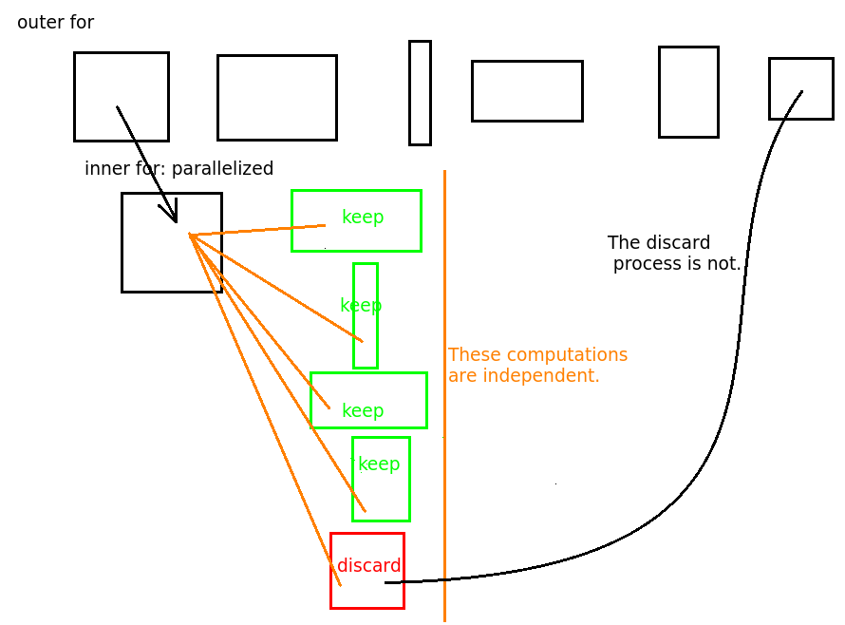
Parallelization: OMP
Inner loop only, because we’re throwing out boxes as we go along
All threads compare box i to a unique box j
Threads mark j as discarded
Data parallel: j boxes are in organized array, each thread process unique j
Task parallel: Each comparison is an independent task
2x speedup over serial c
Many threads are idle in later iterations

Slide 23
Parallelization: OMP
The for loop over the columns is parallelized
No data dependencies between threads.
Each thread writes to different index in the keep array
However, on later iterations of the outer loop, many threads do no work
Probability
 |  | X |  |  | X | X | X
Probability
¾ of the threads are idle in this iteration. Bad!
All of the threads are idle in this iteration. Bad!

Slide 24
Parallelization: OMP unordered
Parallelize the outer for loop of the unordered algorithm
~7x speedup compared to serial C
Not entirely accurate, since we are not going strictly by order of probability
Still task and data parallel
Data parallel: we iterate over an unsorted array of boxes now
Task parallel: each comparison is unique

Slide 25
Parallelization: OMP unordered
Ex: Three rows in parallel
Parallelize the outer for loop
Threads do not need to communicate, since they perform all possible computations
Later unnecessary rows are skipped completely
Compare this to previous implementation
 |  | X |  |  | X | X | X
 |  |  | X
X |  |  |  |  | X | X | X
Dynamic scheduling lets threads move on to next row. Ex: Blue thread sees to skip row 6, is rescheduled to row 7

Slide 26
Parallelization: OMP Alternate
Probability
Parallelize the columns of the serial algorithm, starting from low probability boxes
No interthread communication, threads all write to unique position in keep array
Slow, many excess computations are performed. 0.2x as fast as serial c
We must compute down every column
Task parallel: Seeing if we want to keep box X is a task
Data parallel: Boxes are still in a sorted array
 |  |  |  |  | X |  | X
 |  |  |  |  |  | X
Probability

Slide 27
Parallelization: SIMD

Slide 28
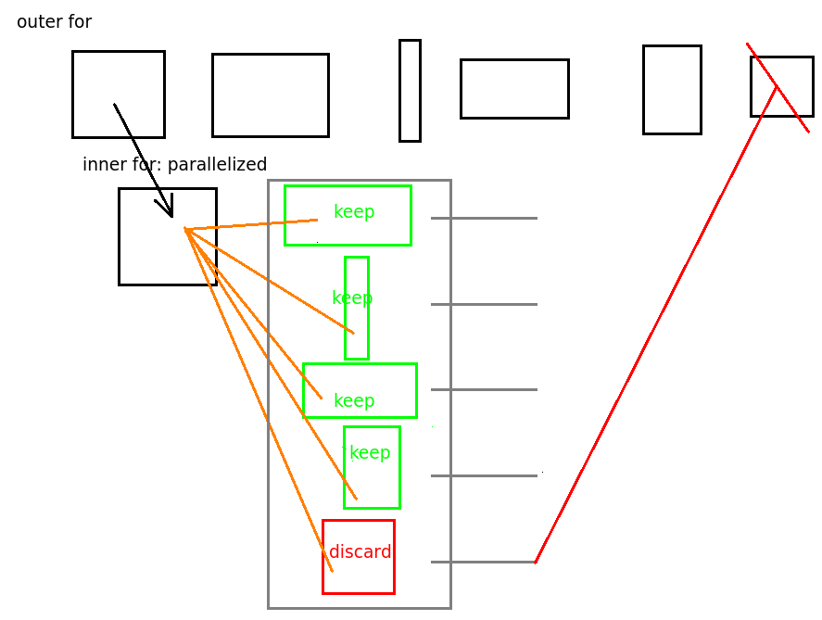
Parallelization: SIMD
Vectorized the individual iou comparisons among boxes
Gather and compute ratios in batches, then compare ratios and discard in groups
Used alongside OMP
9x speedup compared to serial C
No error unlike unordered C

Slide 29
Parallelization: SIMD
Computation down rows (outer for loop) is serial
Probability
Comparisons and keep decisions are performed in batches of 8 using AVX. Each set of 8 is handed to own thread
 |  | X |  |  | X | X | X
Similarity to serial version lets us skip many rows. Both computationally efficient and parallelized!
Probability
Padded array lets us reference off the edge safely. Lets us keep the work in one for loop

Slide 30
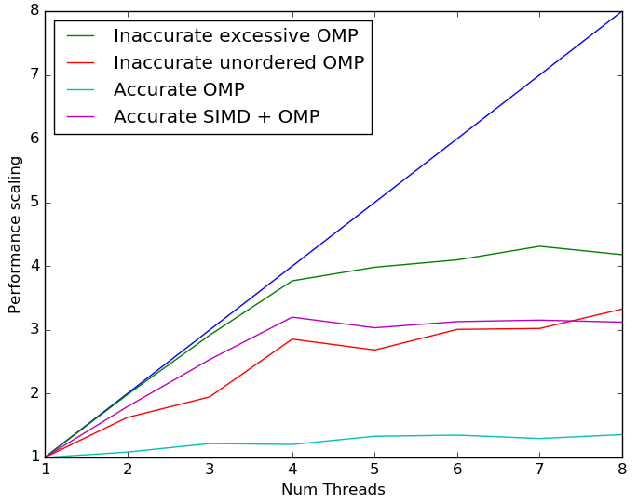
Scaling Plot
As expected, drop off of scaling after 4 threads due to availability of only 4 physical cores.

Slide 31
Algorithm: Patterns
Notes:
We also have experimented on trying to parallelize the NMS algorithm on a GPU.
Since we are using GPUs, the implementation strategy would be kernel parallelism and the execution target arthictecture would be GPU SIMD
We use Titan X GPU which has over 3000 cores, a clock speed of 1000 Mhz, and has the computational power of 206 Gflops double precision.

Slide 32
Parallelization: GPU
Each work item calculates the IoU of only one pair of bounding boxes
Discard process is omitted, it requires inter-workitem communication
Result is slow because of overhead - has to:
set up the kernel
load data to the GPU
copy result back to the host
3x speedup (ignoring setup time)
Results agree with the ICASSP paper. (See references)
Notes:
So I will explain how the NMS algorithm is run on the GPU.
The GPU first loads all the bounding boxes and then each work item calculates the IoU of only one pair of bounding boxes.
In other words, we are not only parallelizing the outer loop of the algortihm, we are parallelizing the inner loop as well by doing every computation possible.
we also omit the discard process because the overhead of flagging the boxes as discarded and writing that into an array overwhelms the computation. Despite this effort, result is slow because of other overheads.

Slide 33
Overview
Project Description
Algorithm
Naive Code
Parallelization
Results

Slide 34
Results: Speedup (100 images, 15000 boxes/image)
Implementation | Total Time (s) | Speedup (x serial C) | Speedup (x serial Python)
Serial Python | 553.949 | 0.008 | 1.000
Serial C | 4.446 | 1.000 | 124.6
OMP | 1.987 | 2.237 | 278.7
OMP Unordered | 0.618 | 7.196 | 896.6
OMP Alternate | 14.852 | 0.299 | 37.30
SIMD + OMP | 0.472 | 9.414 | 1173
GPU | 1.397 | 3.182 | 396.5

Slide 35
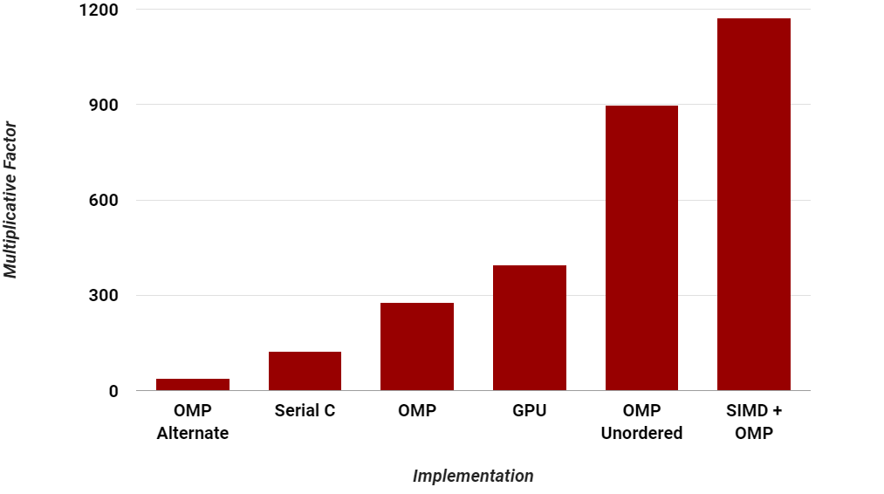
Results: Multiplicative Speedup over Python

Slide 36
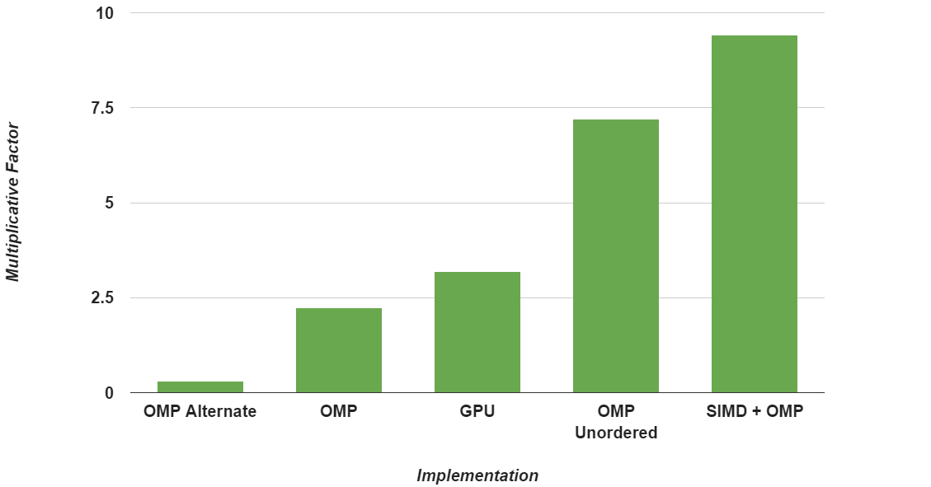
Results: Multiplicative Speedup over C

Slide 37
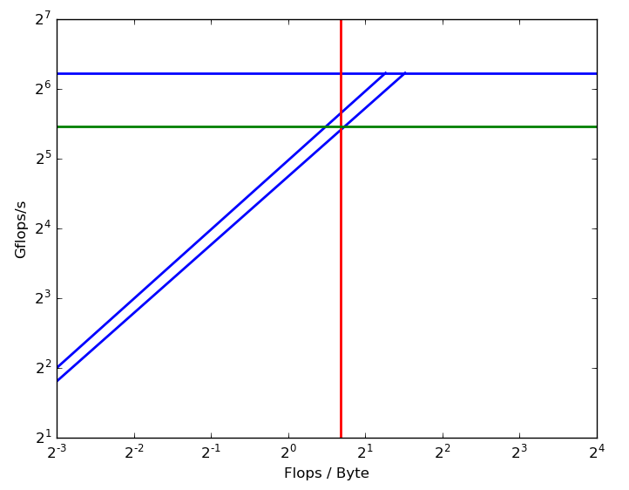
Roofline Analysis
18% away from peak performance, given our algorithm
Arithmetic Intensity = 32/20 = 1.6 Flops/Byte
CPU SIMD Performance = 43.78 GFlops/s
Possible L3 Performance = 41.6 GFlops/s
Possible L2 Performance = 52.8 GFlops/s
Peak Flops
CPU SIMD performance
L2 Cache
L3 Cache
Arithmetic intensity

Slide 38

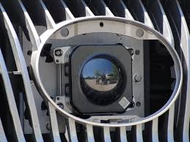
Results: Speedup
We started with something that took >5min for 100 images, or >3s per image
Not feasible, when a car camera is going at 60fps = 1 frame/12 ms
We cut the time down to ~5ms per image!
This makes using NMS on real-time image processing feasible, possibly on multiple cameras! Cool!

Slide 39
More Thoughts
Our unordered algorithm performed slightly better than the traditional algorithm, at the cost of accuracy
0.19% error compared to serial code
Error comes from bounding boxes with equal probabilities
More work is needed to see if this error is acceptable
SIMD+OMP was logically equivalent to Bichen’s code; 0% error
Error calculated by comparing bounding box output list for a test dataset between our function and Bichen’s serial python function
GPU NMS may still be feasible
Since many computer vision methods run on GPUs, the CPU to GPU memory transfer may be avoided

Slide 40
Resources/References
Neubeck, Alexander, and Luc Van Gool. "Efficient non-maximum suppression." 18th International Conference on Pattern Recognition (ICPR'06). Vol. 3. IEEE, 2006. https://pdfs.semanticscholar.org/52ca/4ed04d1d9dba3e6ae30717898276735e0b79.pdf
Oro, David, et al. "Work-efficient parallel non-maximum suppression for embedded GPU architectures." 2016 IEEE International Conference on Acoustics, Speech and Signal Processing (ICASSP). IEEE, 2016. http://ieeexplore.ieee.org/iel7/7465907/7471614/07471831.pdf
http://www.pyimagesearch.com/2014/11/17/non-maximum-suppression-object-detection-python/
http://www.pyimagesearch.com/2016/11/07/intersection-over-union-iou-for-object-detection/

